Slide 1
University Roles in Science, Innovation and HQP in the Canadian Agri-food System
Presentation to Federal-Provincial-Territorial Deputy Ministers
by the Association of Canadian Faculties of Agriculture and Veterinary Medicine
23 April 2013
Montreal

Slide 2
ACFAVM
Five Veterinary Medicine Faculties
  University of Calgary
  University of Saskatchewan
  University of Guelph
  Université de Montréal
  University of Prince Edward Island
Eight Agri-food Faculties
  University of British Columbia
  University of Alberta
  University of Saskatchewan
  University of Manitoba
  University of Guelph
  McGill University
  Université Laval
  Dalhousie University

Slide 3
ACFAVM Mission
“Canada’s leading catalyst for the development and
adoption of science and veterinary technology for the
agricultural and food industry at home and abroad, and
The primary sources for undergraduate and graduate
education to serve the growing needs of the industry and
governments.”

Slide 4
Agriculture and Food Research
Research in the eight agriculture faculties:
  Over $350 million in 2010-2011
  12,517 published papers 2003-2010
Member Universities, not CFAVM faculties
  20,907 published papers 2003-2010
Agriculture and Agri-food Canada
  6,363 papers published 2003-2010
Provincial staff also published papers
Canada overall:
  High impact, high intensity
  8th in the world for published papers (2010)
  9th in the world for impact (2010)
Sources: Assessment of the Scientific Output of CFAVM Members, Science Metrix: Prepared for the Canadian Faculties of Agriculture and Veterinary Medicine (CFAVM).
Internal ACFAVM study on research investments.

Slide 5
Agriculture and Food Research
Research in the eight agriculture faculties:
  Over $350 million in 2010-2011
  12,517 published papers 2003-2010
Agriculture and Agri-food Canada
  6,363 papers published 2003-2010
Provincial staff also published papers
Canada overall:
  High impact, high intensity
  8th in the world for published papers (2010)
  9th in the world for impact (2010)
Source: Assessment of the Scientific Output of CFAVM Members, Science Metrix: Prepared for the Canadian Faculties of Agriculture and Veterinary Medicine (CFAVM)

Slide 6
Agriculture and Food Research
“…Canadian patents related to ICT, Chemicals, and AgriFood have a greater impact than the world average”
“…Canadian research in Agriculture, Fisheries, and Forestry ranked second in the world”
“…Canada’s share of the world’s scientific publications is particularly high in the fields of … Agriculture, Fisheries, and Forestry.”
“…Canada’s output in almost half of the fields grew more slowly than total world output, most notably in Agriculture, Fisheries, and Forestry…”
Source: “The State of Science and Technology in Canada, 2012”

Slide 7
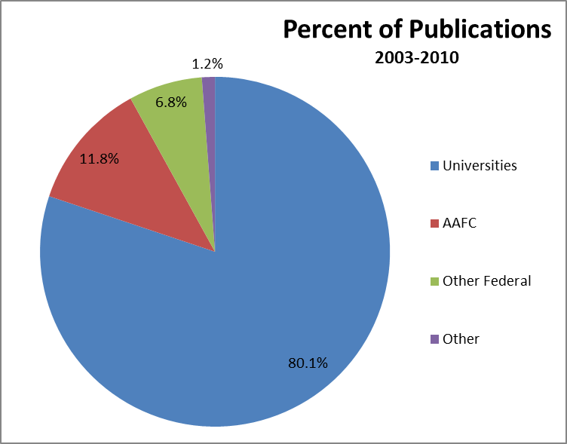
Agriculture and Food Research

Slide 8
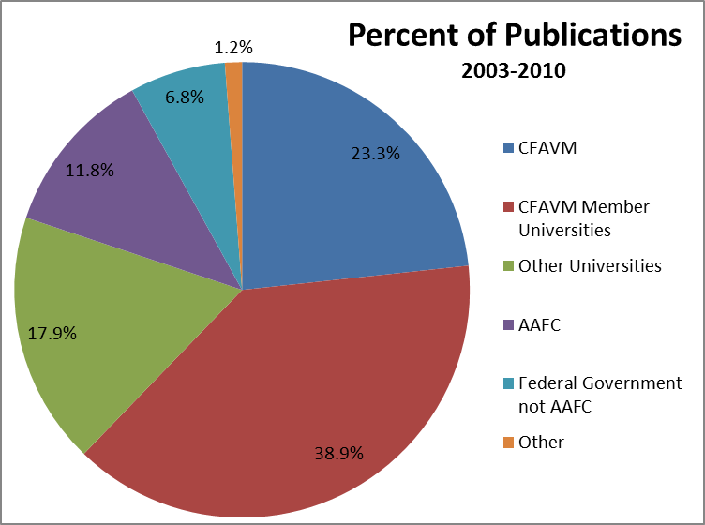
Agriculture and Food Research

Slide 9
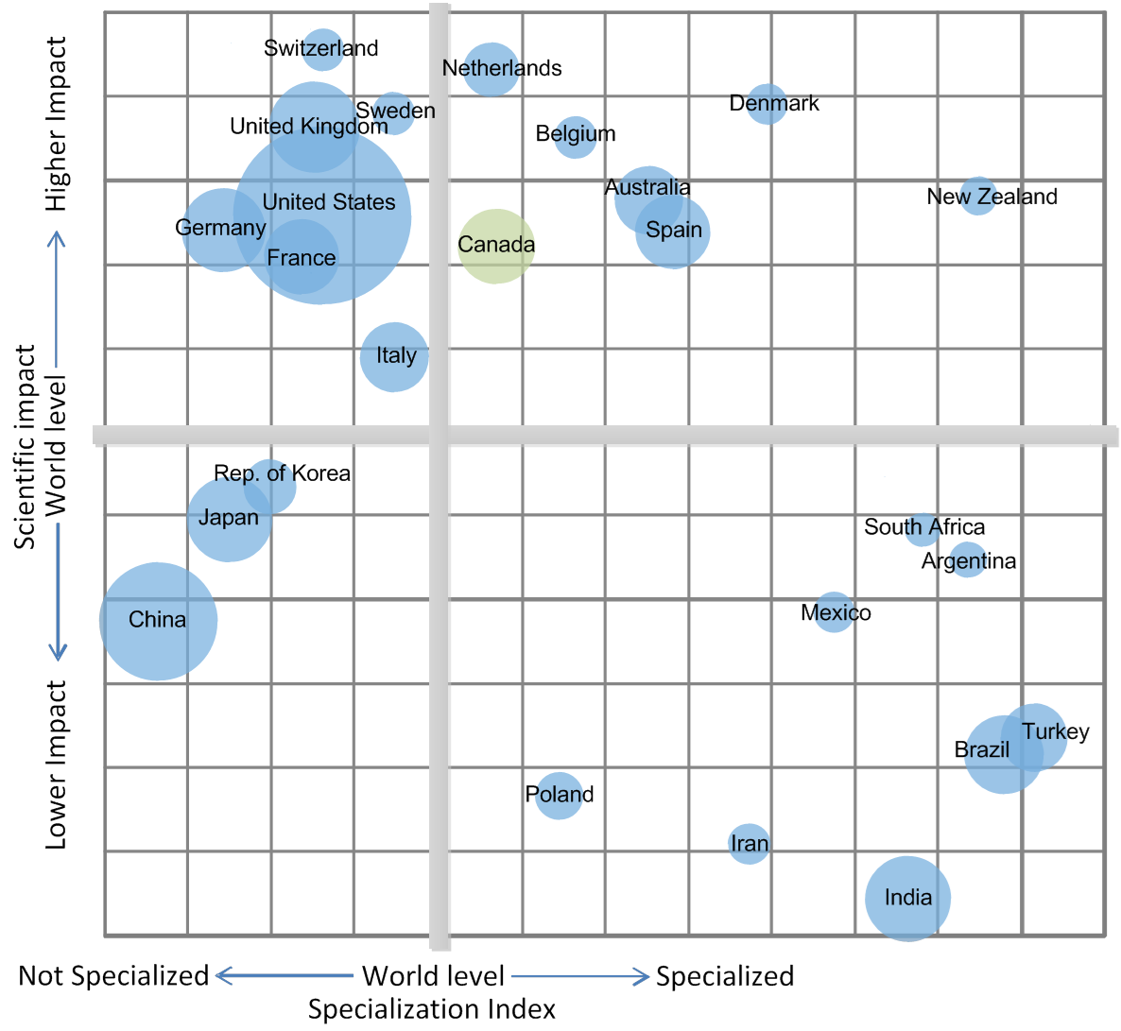
"Positional analysis of leading countries in Agricultural and Veterinary Sciences (2003–2010) Number of papers (area of circles), scientific impact (ARC), specialization index (SI)"
Source: Assessment of the Scientific Output of CFAVM Members, Science Metrix

Slide 10
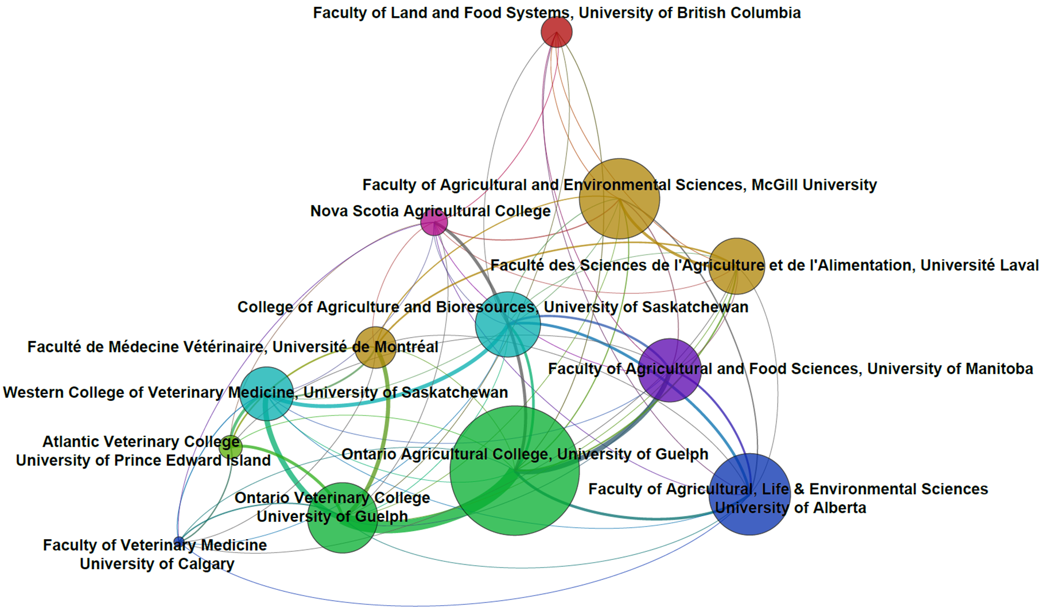
Collaboration network of CFAVM members in Agricultural and Veterinary Sciences
(2003–2010)

Slide 11
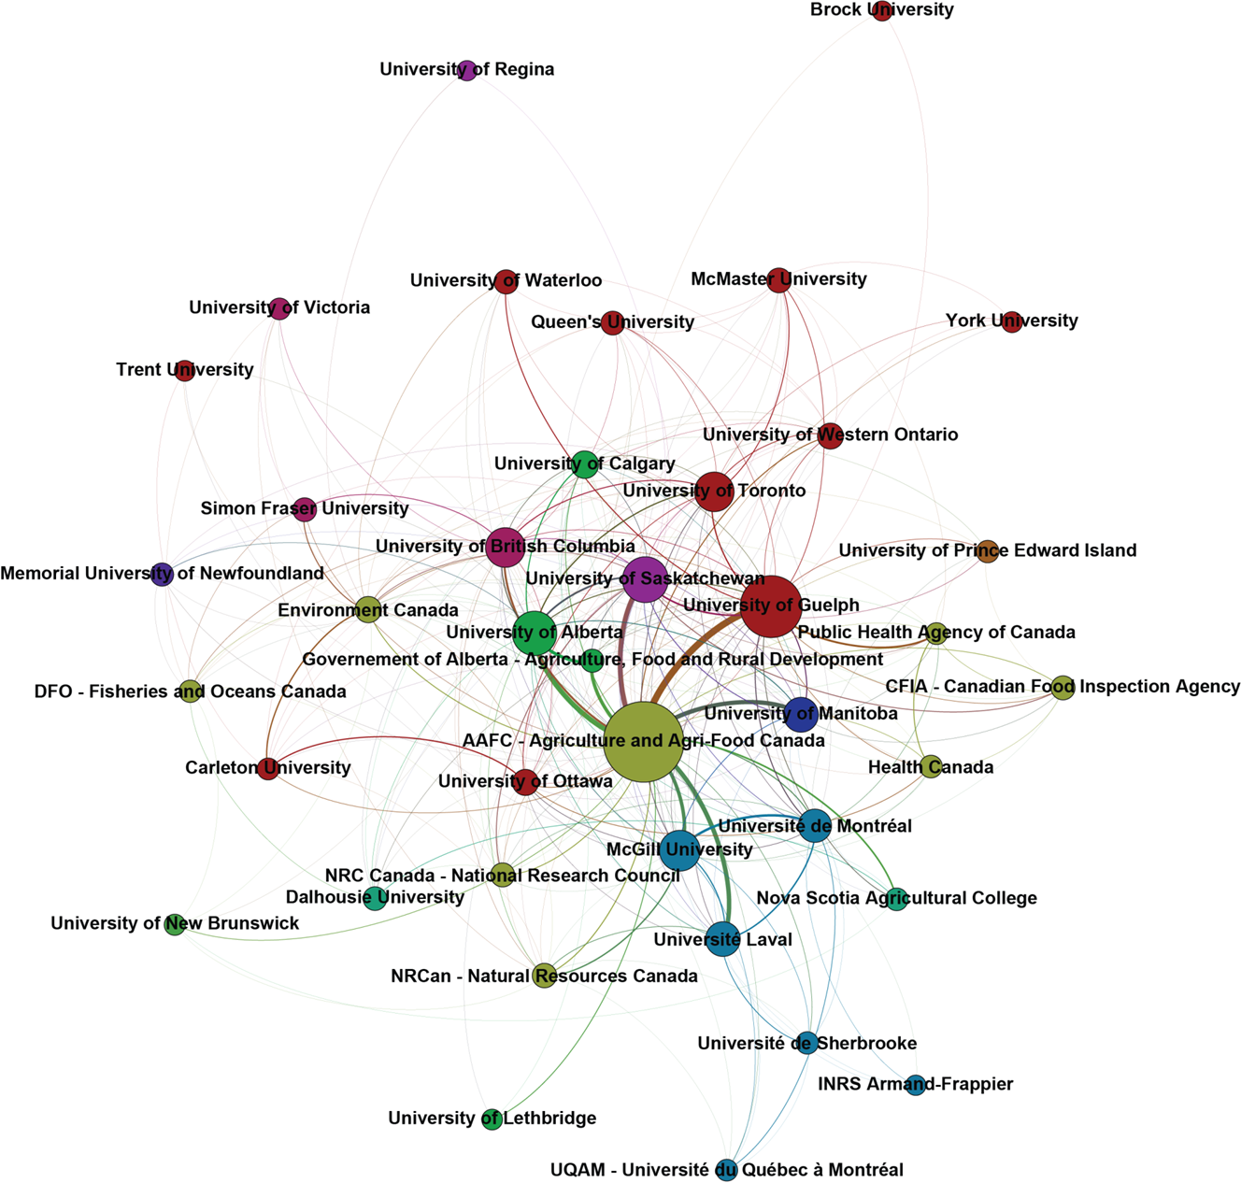
Collaboration network of leading Canadian institutions in Agricultural and Veterinary Sciences (2003–2010)
Source: Assessment of the Scientific Output of CFAVM Members, Science Metrix

Slide 12
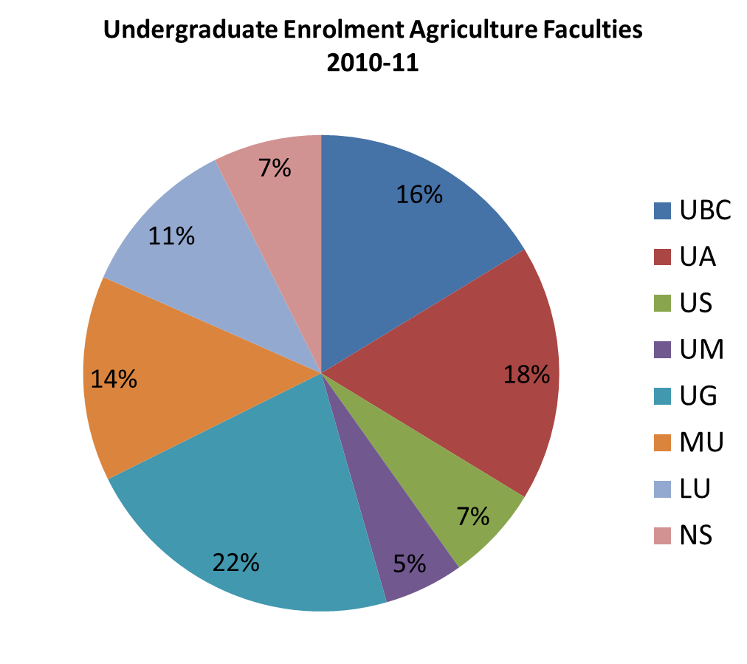
Human Resource Development
N = 8210

Slide 13
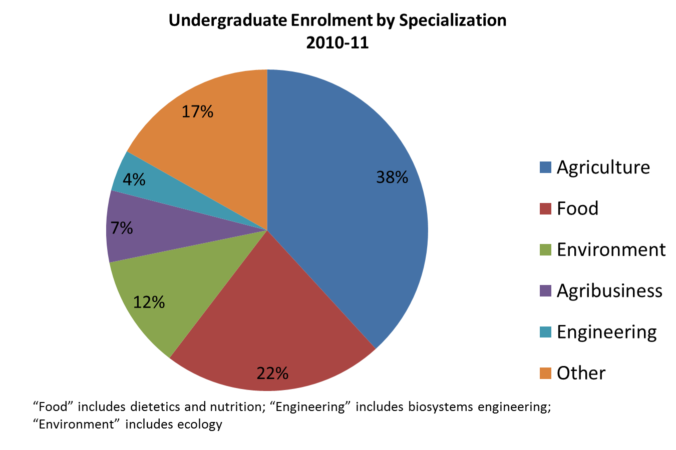
Human Resource Development

Slide 14
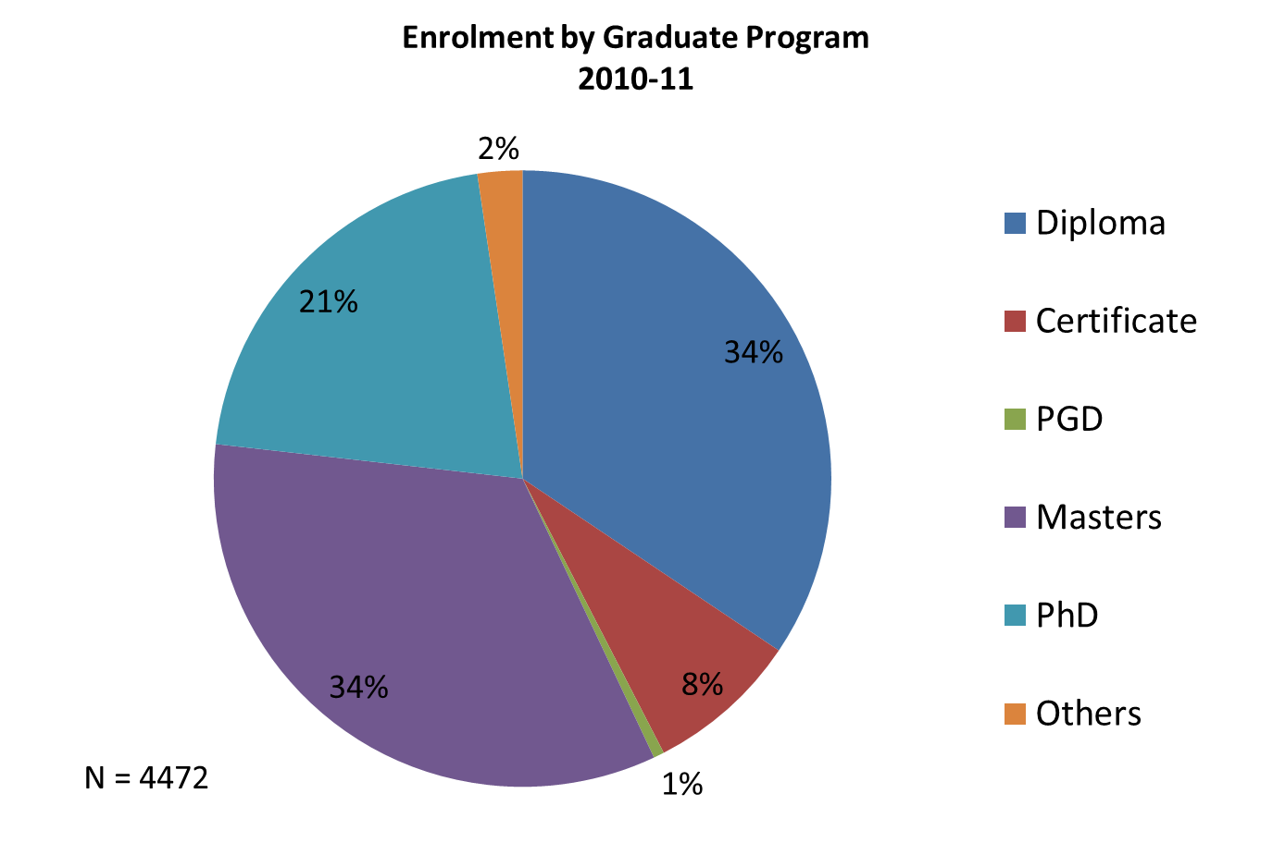
Human Resource Development

Slide 15
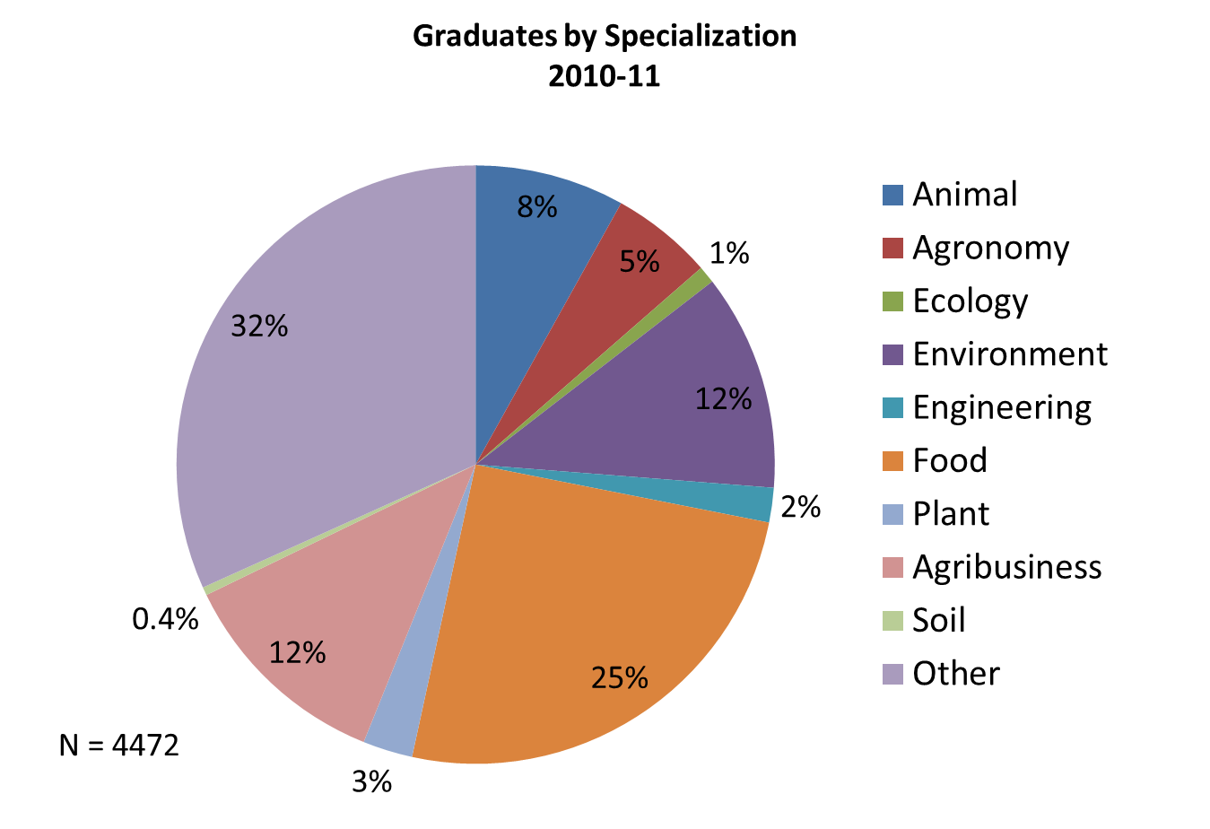
Human Resource Development

Slide 16
Human Resource Development
Enrolment stable or rising after a period of modest decline
  Where budget limits growth in enrolment, entry bar is rising
  Growth is occurring:
    U Manitoba has doubled undergrads in past 7 years
    Grad student numbers at U Alberta increased 40 % in past five years
  2/3rds are female
  Post grad increasing; over 50% are foreign students
Wider course offerings in all faculties
  Agro-ecology, environment, resource management, nutrition, dietetics, bioresources, biosystems engineering
Graduates get jobs!
  e.g., U Manitoba ag grads have 1.85 job offers by graduation
  No “involuntary” unemployed DVMs on graduation

Slide 17
Human Resource Development
Veterinary Faculties:
  Stable DVM enrolment
    Limited by capacity and agreements
    More applicants than can be accepted
  Large and growing postgraduate population
    Both domestic and foreign
  Covers domestic animals, wild animals, and fish
  Internationally accredited
  Home to Veterinarians Without Borders

Slide 18
Research Investment
Agricultural productivity gains are different
  New varieties and their traits have a limited life span
  Diseases and pests eventually overcome virtually all varieties; speed and virulence vary
  Animal diseases/zoonotics also mutate with time
Major investments needed to simply maintain crop and animal yields
Only investments over and above maintenance research offer potential gains in productivity

Slide 19
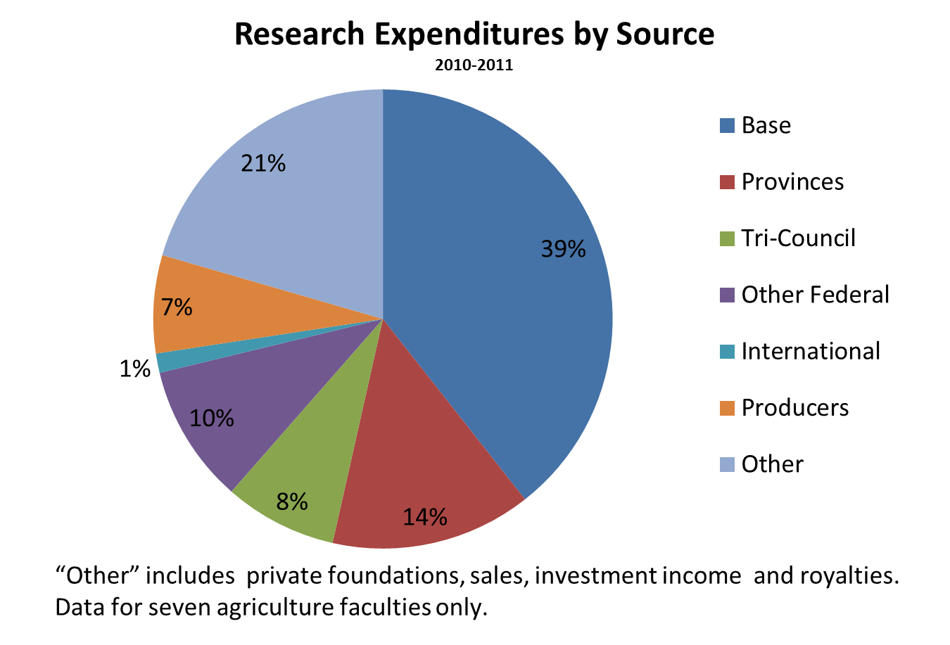

Slide 20
The Realities
Universities:
  Professorial advancement based on science output
    Published articles, IP and patents are “end products” in universities
    Growing recognition given for innovation joint with private firms
    Innovation is often commercial confidential, not publishable
  Breadth of science in agriculture faculties much wider today
    To attract students to the faculties
    To play to Canada’s S and T priorities
    But this results in hollowing out agri-food productivity research

Slide 21
The Realities
University research generates IP from both public and private funds
Universities have basically three options:
  Make it openly available
  Build walls around IP; wait for industry to climb the walls with money in hand
  Turn it over to the funder or an IP pool
Several difficulties noted in university tech transfer in Canada
  Over pricing
  IP thickets
  IP protection and non-disclosure
Often individually negotiated confidential agreements between government and universities on IP arising from research
Notes:
Trosow, Samuel; McNally, Michael B.; Briggs, Laura E.; Hoffman, Cameron; Ball, Cassandra D.; Jacobs, Adam; and Moran, Bridget,
"Technology Transfer and Innovation Policy at Canadian Universities: Opportunities and Social Costs" (2012). FIMS Library and
Information Science Publications. Paper 23.
http://ir.lib.uwo.ca/fimspub/23

Slide 22
The Realities
Many obstacles to innovation and using IP:
  Governments fear that a private sector firm will make money from promising public research results
  Corporations hesitate to collaborate with competitors
  Publicly funded and publicly available innovations often ignored: private sector cannot recoup design, scale-up and marketing expenditures based on innovations available to all
Source: Harvey Drucker, Technology Transfer: A View from the Trenches. Proceedings from the conference ``Maximizing the Return From Genome Research,'' held 23-24 July 1993.

Slide 23
The Realities
Very few Canadian-based food processors
  Only 4 in the top 50 North American food and beverage sellers (2011)
  Combined sales smaller than each of the top four
  No Canadian processing equipment manufacturers
Research funding mostly controlled by head offices located abroad
Some “project” research supported in Canada by international firms
  Rarely support “programs” of research
  But the case has not really been made either
Innovation often embedded in foreign direct investments
Notes:
For North America only:
Saputo, 19th in 2011, sales 1/5th of NA leader
Maple Leaf, 24th in 2011, sales 1/6th of NA leader
Agropur, 32nd in 2011, sales 1/9th of NA leader
McCain Foods, 44th in 2011, sales 1/12th of NA leader
Parmalat Canada: excluded as a wholy owned subsidiary of Parmalat Group, which is 83.3 percent controlled by the Lactalis Group (France)
Ranking based on http://www.foodprocessing.com/top100/
Recalculated/ranked on food and beverage sales only. Years may vary across companies.

Slide 24
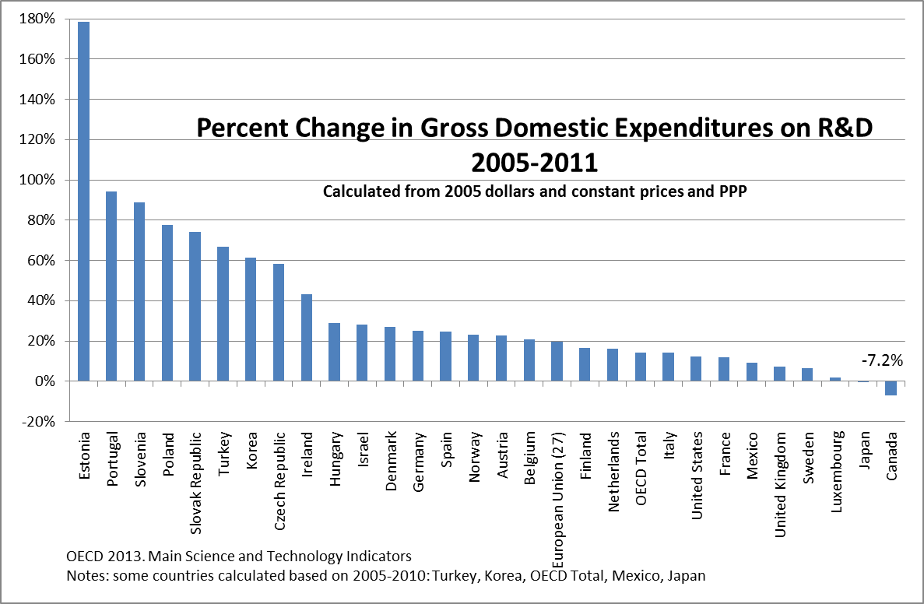
Canada’s share of private industry research is below that of both USA and Europe.

Slide 25
Take-aways
HQP development appears robust
  But very limited collaboration across universities
  Provincial silos; more open across national boundaries
Research collaboration among many universities
  Well-positioned over all internationally…impact and specialization
  Project oriented, much less “program” oriented
Long term research leading to innovation is a weakness
  Incremental innovation common, major FDI role
  Game-changing research for innovation less common
Major gap between research and private innovation:
  too risky for processing firms to undertake

Slide 26
Take-Aways
Need to strengthen funding from producers and processors
  National funding arrangements for producers
  Tap funding from processors with “programs” of research
Domestic partnership platforms needed for “programs of research”
  For funding, for goal-oriented research networks
  It’s less about urging processors to do research and more about enabling processors to fund research

Slide 27
Take-Aways
Goal-oriented research networks
  Wide range of disciplines, several partners, including innovators
  Does industry need anti-trust protection to enable collaboration?
Examples include:
  Beef productivity, nutrition, health management, feedstuff improvement, environment, gene mapping for selection across multiple traits
  Food safety
  Environmental and resource sustainability, including adaptation to climate change
  Adapting our plants and animals/meats to user and consumer demands
These examples are described in the CFAVM report to the Senate Standing Committee, June 2012

Slide 28
Finally…
Major strengths in governmental and university-based research
  Each party has specific roles
  But they also have overlapping roles
Private industry has a role: but weaknesses abound
  External industry ownership
  Domestic innovation shy
Can we find business models/platforms across all partners to build on our strengths?

Slide 29
ACFAVM extends thanks to the
Federal-Provincial-Territorial Deputy Ministers
for the opportunity to work toward
collaborative partnerships
in HQP development,
and research and innovation
for agriculture and food

Slide 30


